Slide 1

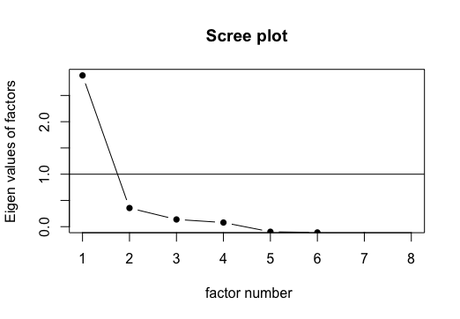
Psychometric Analysis of the National Household Survey¹ on Disaster Preparedness Affinity
Jordan Amann
Department of Biostatistics, School of Global Public Health, New York University, New York, NY, USA
Background
Methods
KEY MESSAGES
(1) The selected items for preparedness affinity demonstrated good reliability and internal consistency.
(2) While there was reasonably good criterion validity of the scale, there was not substantial evidence for construct validity.
(3) Both one and two factor models are reasonable representations of the underlying factor structure of the scale.
Natural disasters pose a substantial threat to individual physical and mental health as well as financial risk. At the household level, preparation for these events can be life-saving (2). Understanding the degree of preparedness and what factors make households more likely to take preparedness actions is essential in developing the appropriate campaigns and programs for increasing said preparedness.
The National Household Survey (NHS) is released each year by the Federal Emergency Management Agency. It collects information about disaster preparedness actions taken by households and includes a set of items that aim to measure the latent degree of household affinity for disaster preparedness. In their summary findings from 2023, FEMA has identified four factors that are likely to contribute to preparedness affinity: awareness of information, disaster experience, preparedness efficacy, and disaster risk perception.
The NHS has limited publicly available analyses of its psychometric properties. This study seeks to enhance understanding of said properties to assess its usefulness as an instrument in more general applications.
The 2023 NHS targeted U.S. adults aged 18+ who spoke English or Spanish. The sampling strategy included oversamples of populations more likely to experience specific hazards and an oversample of American Indian, Alaska Native, and Native Hawaiian or Other Pacific Islanders.
Reliability will be assessed using Cronbach’s Alpha.
Criterion validity will be measured using behavioral variables around self-reported preparedness actions. Construct validity will be measured using economic and household data.
Principle Axis Factor analysis will be conducted to explore the proposed latent influences of preparedness.
Results
Discussion
Sample: The 2023 NHS had 7,604 complete responses with 7% (n=525) of respondents taking the survey in Spanish. Participants from hazard-specific oversamples made up 40% (n=3,029) of responses, and those from the American Indian, Alaska Native, and Native Hawaiian or Other Pacific Islanders oversample made up 7% (n=517).
Reliability: With an acceptable Cronbach’s alpha of 0.75, there is evidence that the items measure the same construct.
Validity: The NHS scale on preparedness affinity demonstrated a good criterion validity with a moderately strong correlation with the total number of preparedness actions taken (r = 0.67). However, there was no evidence to confirm convergent construct validity with the concurrently collected measures in the NHS. No correlations above 0.2 existed with disability status, the number of children and number of adults in the household, homeownership status, income, age, and rural status.
Exploratory Factor Analysis: The scree plot indicated that a one factor solution might be sufficient; however, there was also a noticeable drop in the eigen values after two and four factors. Principle Axis Factoring was conducted for one-, two-, and four-factor structures.
The four-factor model produced indistinct factors with overlapping loadings. The Cronbach’s alpha for individual factors was as low as 0.46.
The two-factor model produced a robust amount of variance explained (43%) while reducing complexity and overlap in factor loadings. The factors can be described as “Disaster Awareness” and “Risk Perception”, with respective Cronbach’s alphas were 0.67 and 0.68. These are both notable decreases from the overall alpha of 0.75.
The single-factor model explained 36% of the variance and showed strong factor loadings across all items.
Main Findings: While the selected items for preparedness affinity are reliable as a psychometric scale and correlated strongly with the preparedness action measure, additional validity analysis is warranted due to the poor construct validity results based on available data for this study. Factor analysis suggests that two of the four hypothesized drivers of preparedness provide a strong factor structure, but there is also evidence to suggest that the selected items can be well explained by a single factor and represent only one underlying construct: preparedness affinity.
Key Limitations: Due to the cross-sectional nature of the survey, test-retest reliability was not able to be assessed.
Key Strengths: The sampling strategy ensured that populations at higher risk for experiencing disasters were properly represented in the national sample.
Opinion: While the items pulled from the NHS are not formally defined by FEMA as a scale, they do demonstrate early signs of forming a strong psychometric instrument. To generate a more comprehensive scale for preparedness affinity, a more robust construct model should be considered.
Further Research: Additional validity research should be conducted, including more content and construct validity assessment.
Study Objective
This study aims to assess the reliability and validity of the NHS’s items that focus on disaster preparedness affinity as a single scale. Internal consistency, factor structure, criterion validity, and construct validity will be assessed. The study will also assess the validity of the four identified factors of preparedness affinity (awareness, experience, efficacy, and risk) through exploratory factor analysis.
References
Federal Emergency Management Agency (FEMA). 2023. “2023 National Household Survey.” https://www.fema.gov/about/research-methodology/national-household-survey.
Keim M. E. (2008). Building human resilience: the role of public health preparedness and response as an adaptation to climate change. American journal of preventive medicine, 35(5), 508–516. https://doi.org/10.1016/j.amepre.2008.08.022

